Slide 1
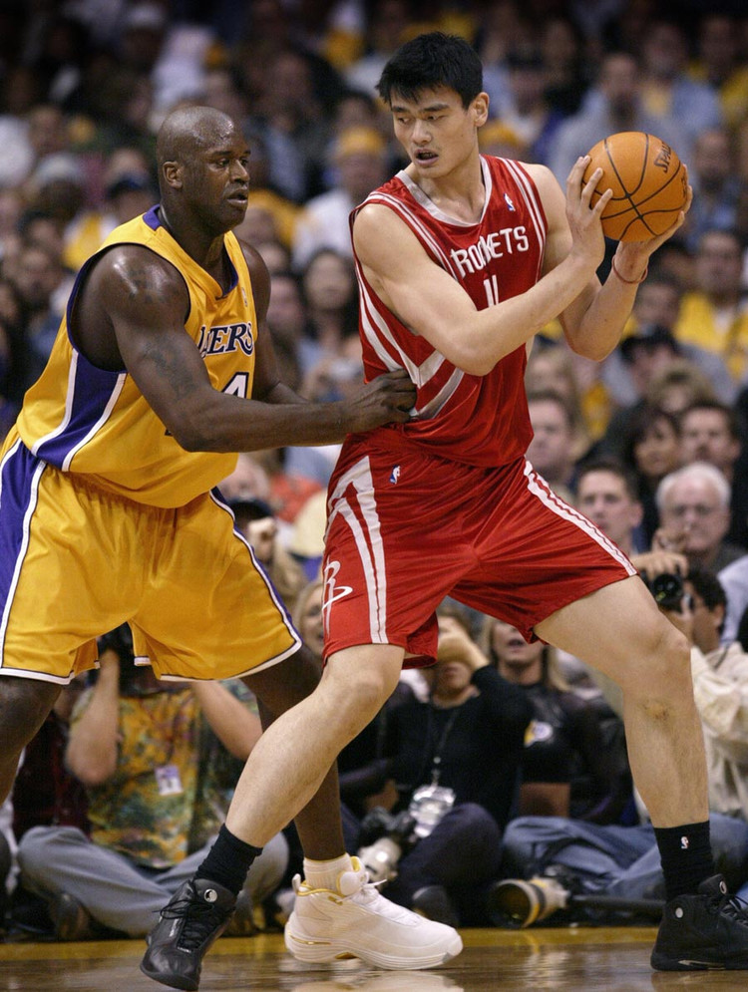
Fantasy NBA Team Optimization
BIA 650-Process Optimization & Analytics
Professor: Edward Stohr
Group Members: Xixuan Hei
Xuan Yang
Yingjun Pan
Ankita Narayan
Huanou Liu

Slide 2
Outline
Introduction & Background
Data Collection
Data Modeling
Optimization & Sensitivity Analysis
Data Visualization
Conclusion & Future work

Slide 3
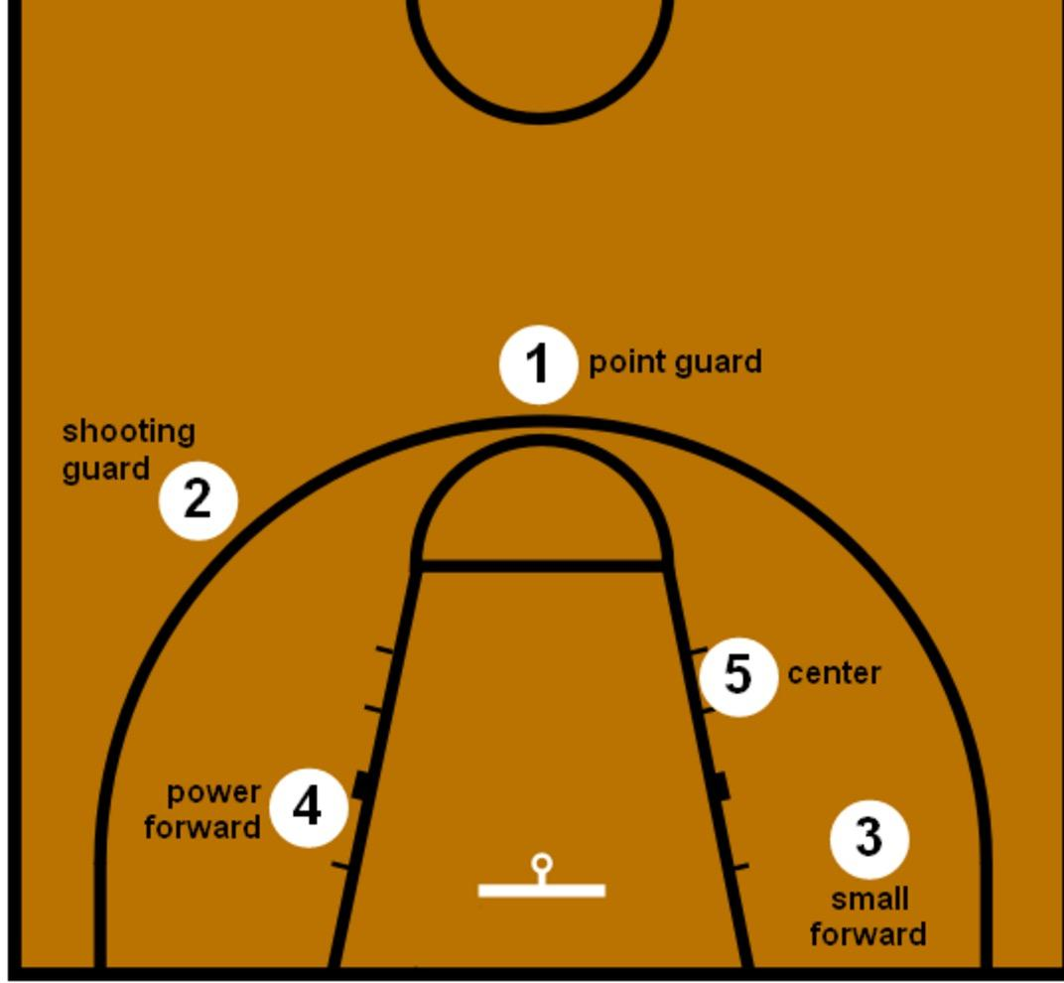
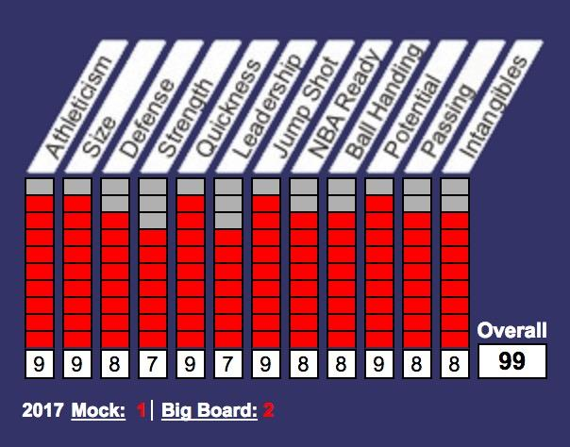
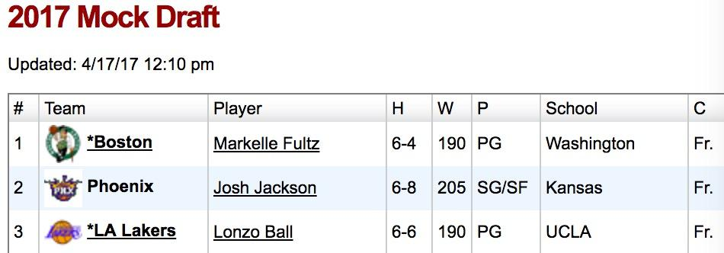
NBA Drafting background
Introduction -data
Position
2 for point guard
2 for shooting guard
2 for small forward
2 for power forward
1 for center
NBA drafting
First round -30
Second round -30

Slide 4
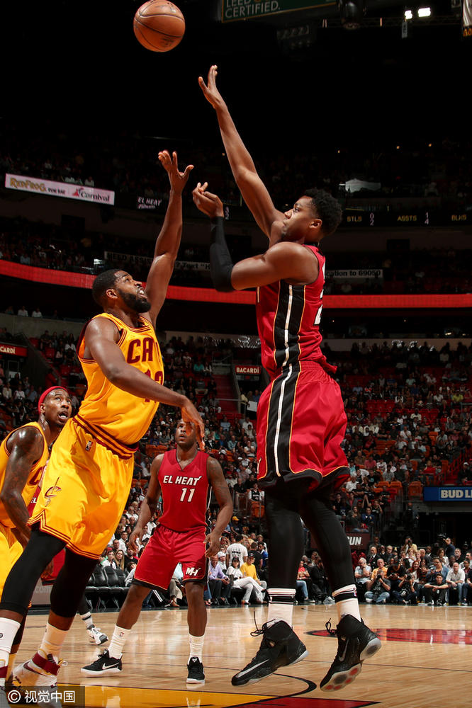
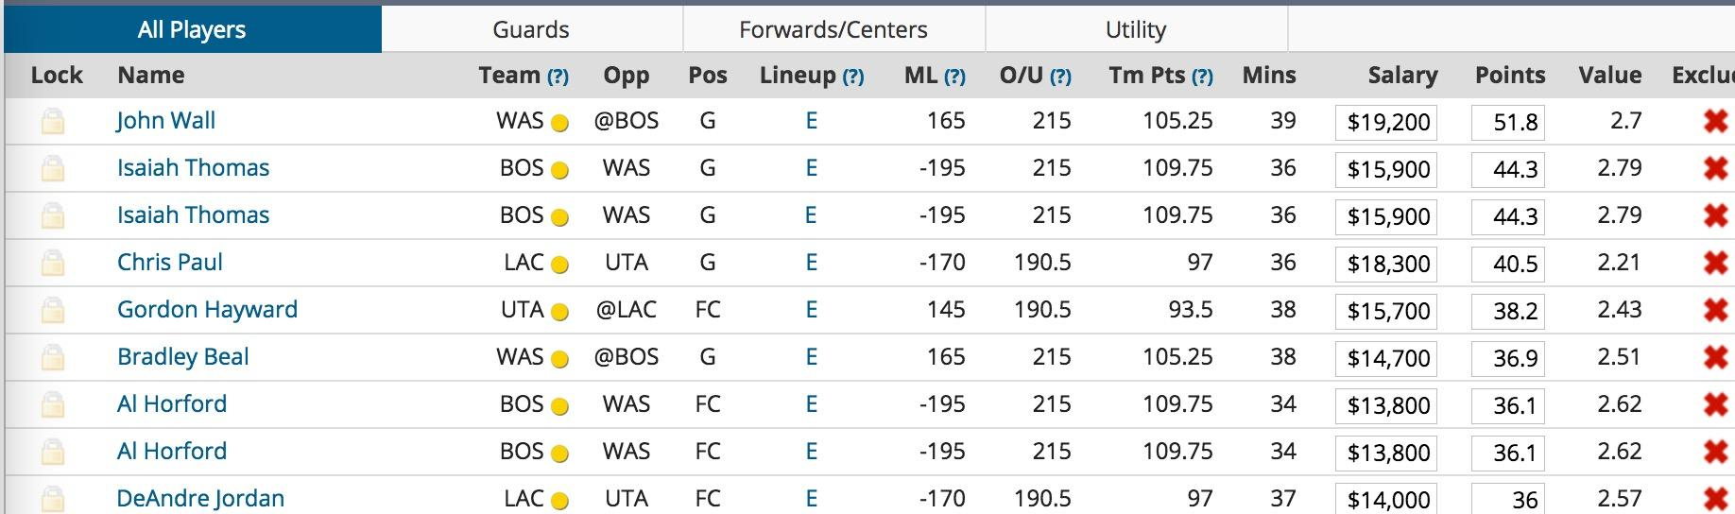
FanDuel NBA Drafting
1.Fantasy basketball drafting:
Policy: position / budget / 2 groups /other
Rules:LiveStandard Draft / Live Auction Draft / Autopick Draft
2.Data Collection

Slide 5

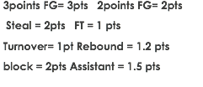
Data Modeling
Model Approach: Linear programming model
The Optimization Model
P_{i} is the projection points, X_{i} is the binary variable(X_{i} is 0 or 1)
Objective: To maximize the overall points the fantasy teams achieved
Decision variables: whether to select player i (Yes equals to 1, No equals to 0)
Notes:
Projection points Algorithm: https://answers.yahoo.com/question/index?qid=20080306224145AAIyWAX
3points FG= 3pts 2points FG= 2pts FT = 1 pts
Rebound = 1.2 pts
Assistant = 1.5 pts
Steal = 2pts
Turnover= 1pt
block = 2pts

Slide 6

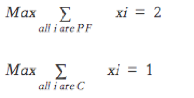


Two Constraints and Output
The budget constraint
C_{i} is the cost (salary) of each player, B is the total budget we have ($60,000)
The number of players in each position
Output : Optimal points(295) and nine players of the fantasy team

Slide 7
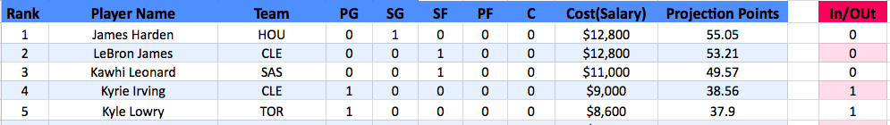
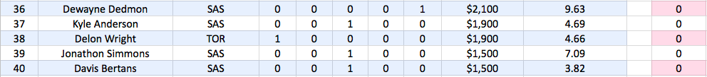
Raw Model

Slide 8
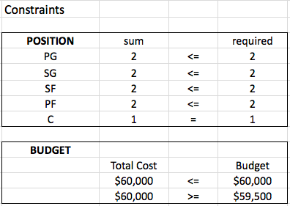

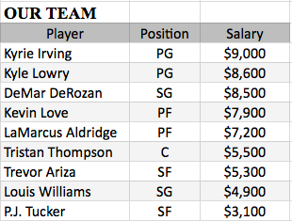
Optimization

Slide 9
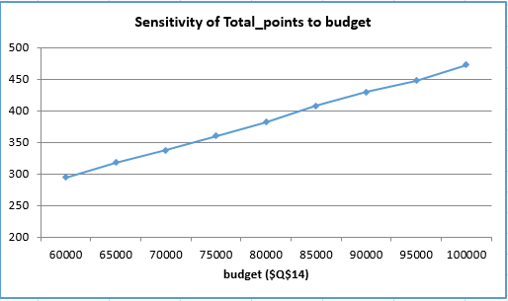
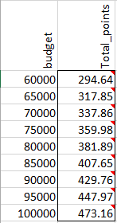
Sensitivity Analysis

Slide 10
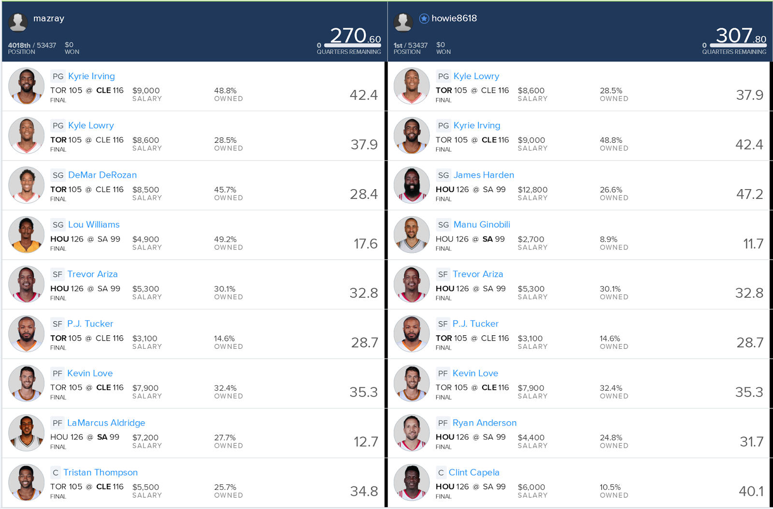
Results & Data Visualization

Slide 11
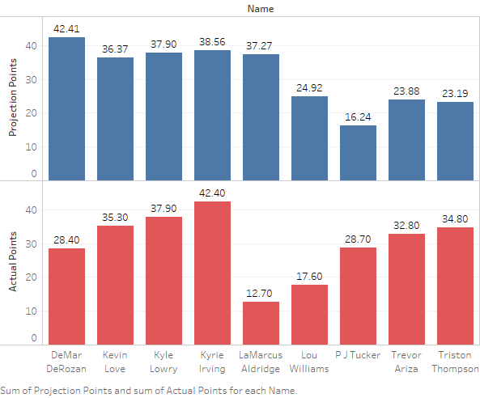
Notes:
Aldridge - 7200 Cost, (37.27-12.70)/37.27= Drop. 65.9% Decline in performance.

Slide 12
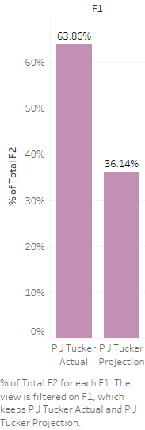
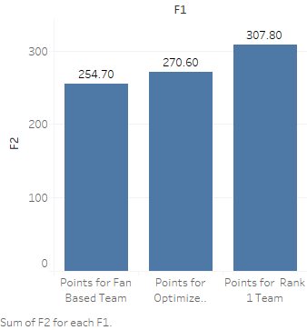
Notes:
Please do regression analysis to compare real performance and historical performance
Home game, health issues, emotional, probable accidents, emergency, luck etc.

Slide 13
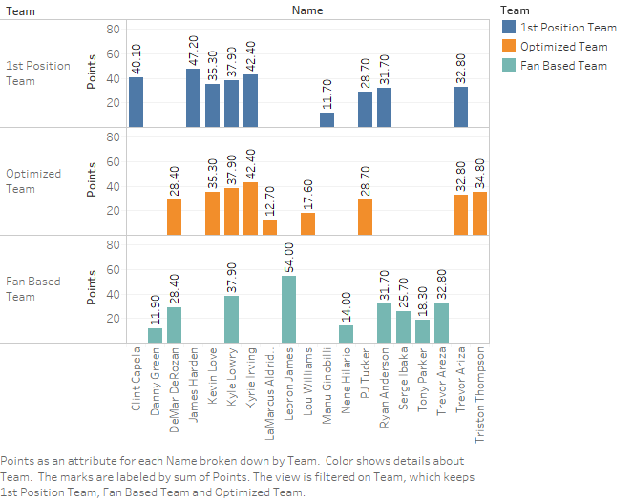
Notes:
James Harden - superstar player - our model didnt picked this player up - may be because he costs a lot -

Slide 14
Conclusion & Future Work
Prescriptive Analytics (Historical & Predictive)
Limitation (Sample Size, factors and needs simulation)
Logistic Regression Model
Sentiment Analysis (Twitter, Facebook)
Hollinger’s PER (Player Efficiency Rating)

Slide 15
Hollinger’s PER Model-Player Efficiency Rating
uPER = (1 / MP) * [ 3P + (2/3) * AST + (2 - factor * (team_AST / team_FG)) * FG + (FT *0.5 * (1 + (1 - (team_AST / team_FG)) + (2/3) * (team_AST / team_FG))) - VOP * TOV - VOP * DRB% * (FGA - FG) - VOP * 0.44 * (0.44 + (0.56 * DRB%)) * (FTA - FT) + VOP * (1 - DRB%) * (TRB - ORB) + VOP * DRB% * ORB + VOP * STL + VOP * DRB% * BLK - PF * ((lg_FT / lg_PF) - 0.44 * (lg_FTA / lg_PF) * VOP) ]
factor = (2 / 3) - (0.5 * (lg_AST / lg_FG)) / (2 * (lg_FG / lg_FT)) VOP = lg_PTS / (lg_FGA - lg_ORB + lg_TOV + 0.44 * lg_FTA) DRB% = (lg_TRB - lg_ORB) / lg_TRB

Slide 16
Thank You !
Reference: https://drive.google.com/drive/u/0/folders/0B4wv7n2EVlnLeXpwc1FQbzJxa2s
https://rotogrinders.com/projected-stats?site=fanduel&sport=nba
http://cs229.stanford.edu/proj2013/ChengDadeLipmanMills-PredictingTheBettingLineInNBAGames.pdf
https://www.stat.berkeley.edu/~aldous/Research/Ugrad/Stanley_Yang%20_Thesis.pdf
https://www.stevens.edu/sites/stevens_edu/files/2016-bia-corporate.pdf

